Slide 1

Analysis of the Atlas of Living Australia’s biodiversity data quality and use cases
Emily Rose Rees
Supervised by Miles Nicholls

Slide 2







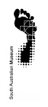















ALA – sharing biodiversity knowledge
$50 million investment
A world-leading collaborative e-infrastructure integral to growing biodiversity knowledge
Partners – founding & beyond
>60 million records
>3100 data sets
>470 spatial layers
>9 billion records downloaded
Data
specimens
occurrence
images, sounds
literature
sequences
more coming……
National Research infrastructure
System
data capture & aggregation
data management
data discovery
data visualisation
data analysis & reporting
Open source & open access
Notes:
$ - have had significant investment over the years – since 2008
Partners – initially came out of the collections, but have a broader demographic now in terms of contributors and users
NCRIS – we are part of
Open source – our software and platform. Open access – how we make the data available so can be freely used and shared
Leading the digital transformation in sharing biodiversity knowledge

Slide 3
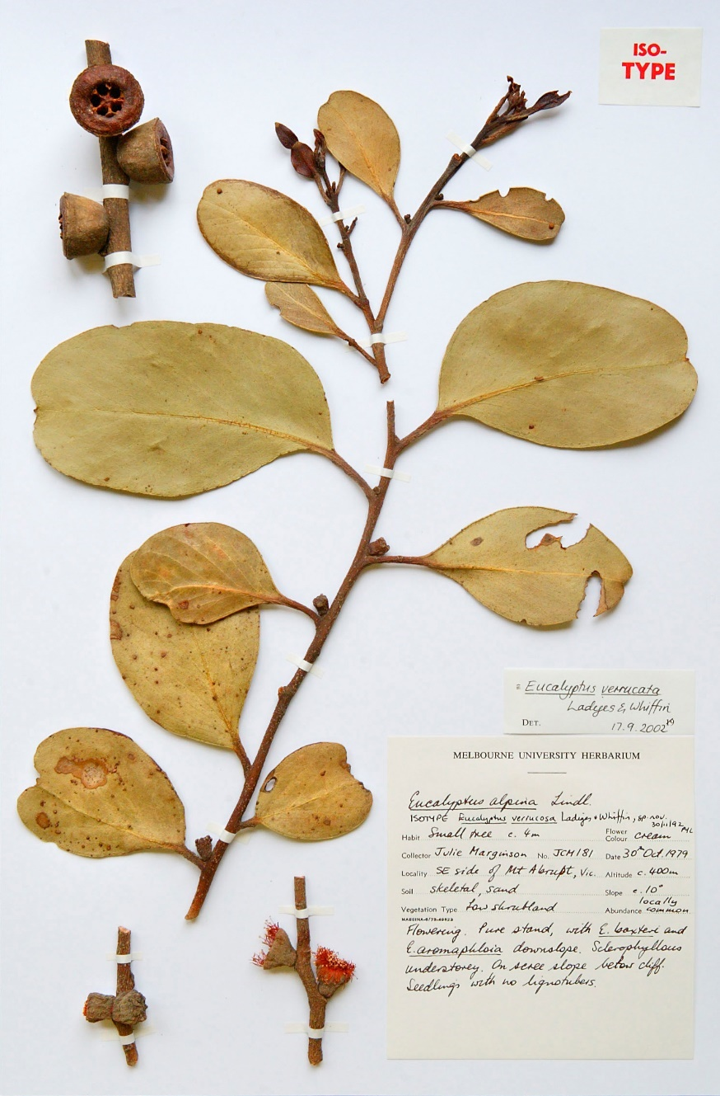

Data Quality
Data is often used for purposes it wasn’t initially collected for
Results are only as good as the data used to generate them
Quality vs Fitness for use

Slide 4
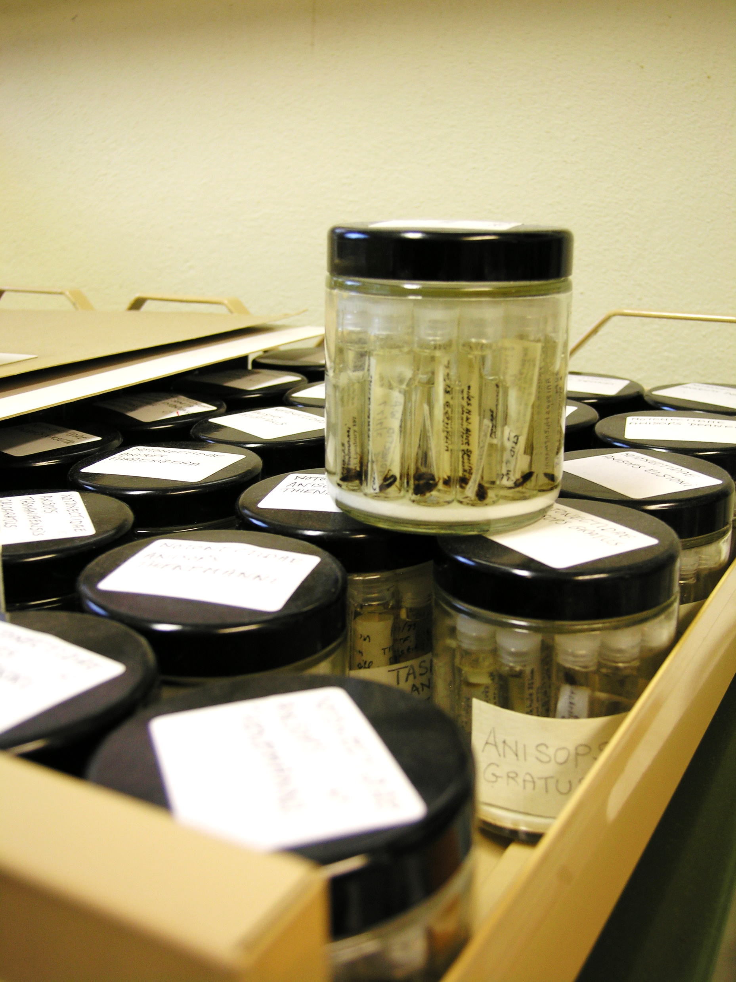
International Working Group
Data quality for biodiversity data, combined initiative of Biodiversity Information Standards and the Global Biodiversity Information Facility (TDWG & GBIF)
Data quality framework ✓
Tools and systems ✓
Data quality use cases

Slide 5
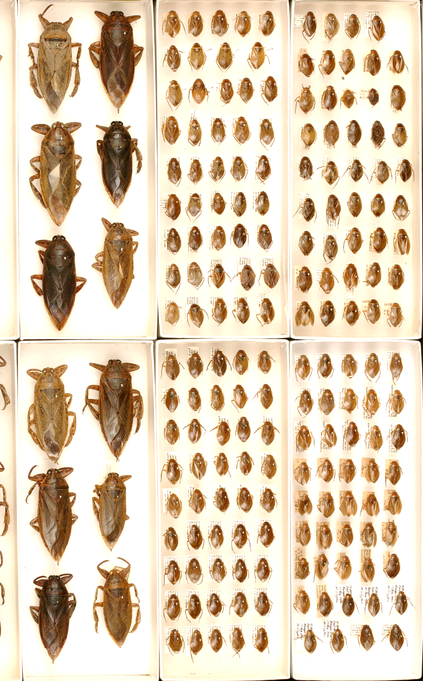
Aims
Feedback into development of data capture and quality assessment tools
Build a use case library
Understand how data is selected for particular purposes
Profiles of most used elements, dimensions, and criteria

Slide 6
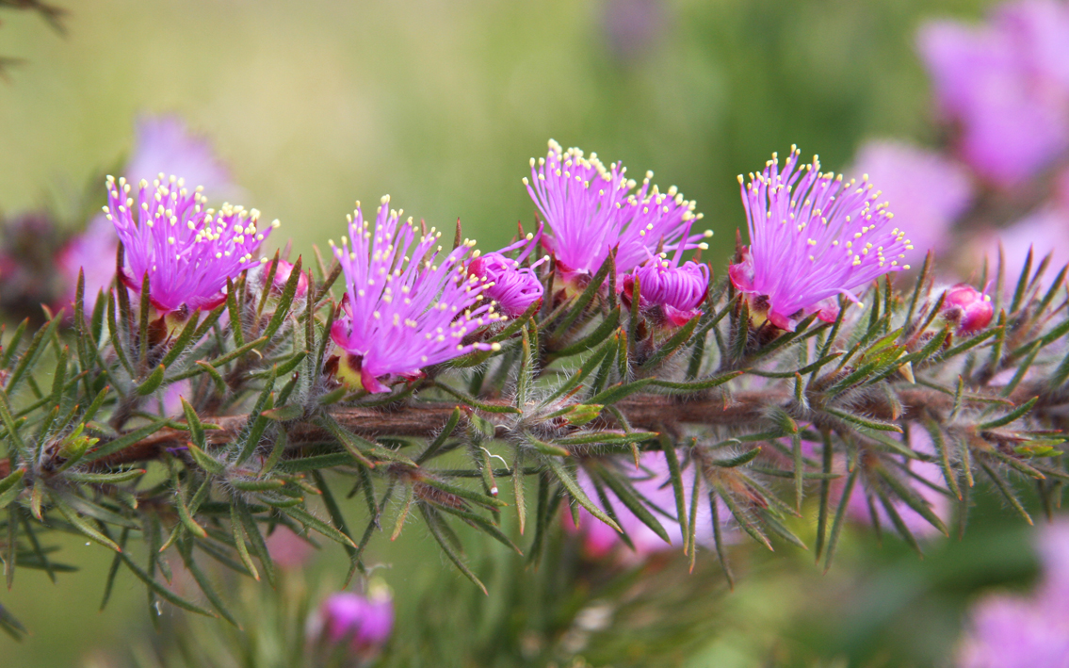
Methodology

Slide 7
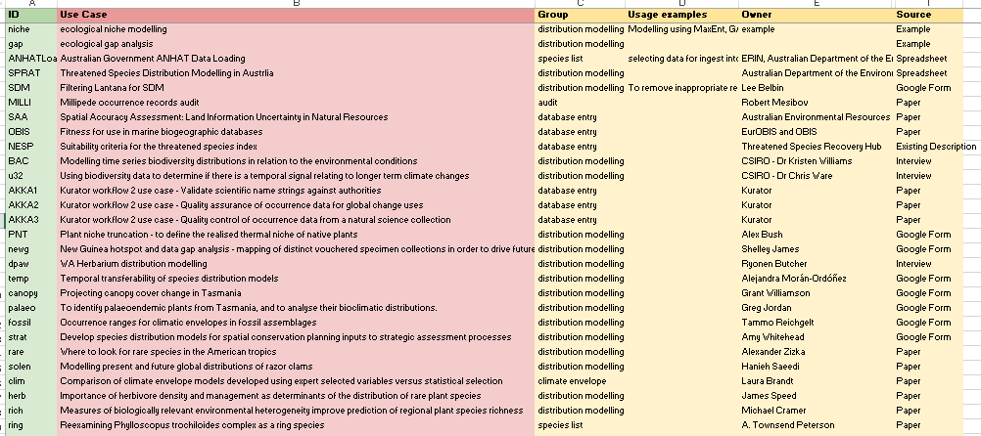
Use Case Library
Use Case Information

Slide 8
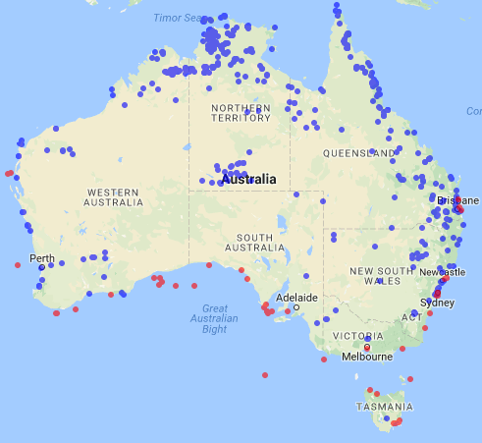
Analysing Use Cases
Information Elements, dimensions and criteria…
c:ANHATCoordinateValue – ‘DQ measure must be in the range’ – area of interest
Coordinates must be between -65, 62 and -8, 172 for marine species, and -44, 112 and -9, 154 for terrestrial species
d:coordinatesValue – ‘value’ – ie:coordinates
ie:coordinates – dwc:decimalLatitude + dwc:decimalLongitude

Slide 9
Results – Information Elements
Mean: 9.21 / 7.89
Median: 9
Mode: 9

Slide 10
Results - Dimensions
Mean: 8.36 / 6.74
Median: 5
Mode: 4

Slide 11
Results – Criteria
Mean: 13.11 / 9.85
Median: 8
Mode: 11

Slide 12
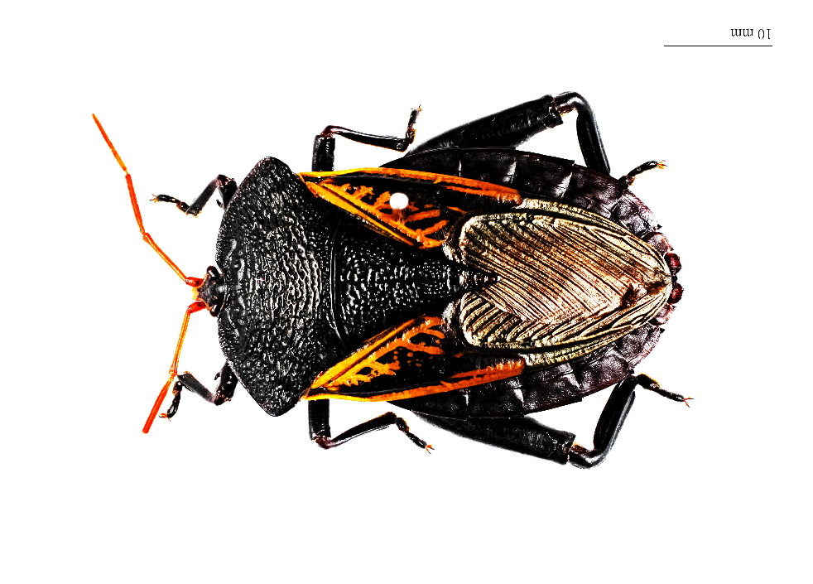
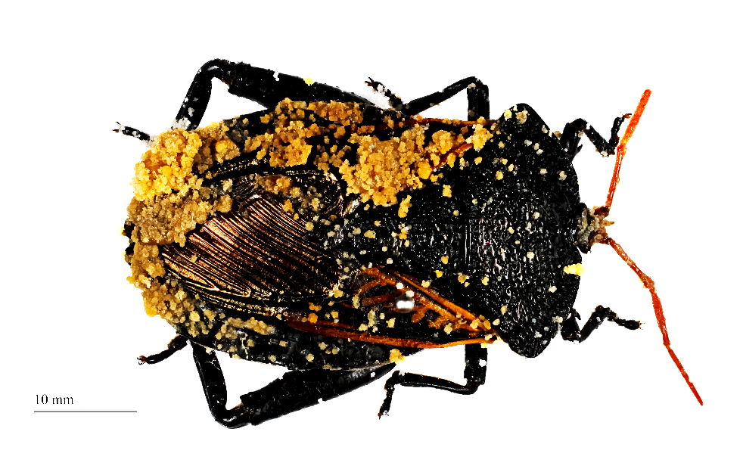
Most use cases are consistently using less than 10 information elements, dimensions or criteria to assess fitness for use
Improving the few that are most frequently used will have the biggest impact

Slide 13
Results
219 elements
257 criteria
Elements and criteria with fewer than three associated use cases are not shown

Slide 14
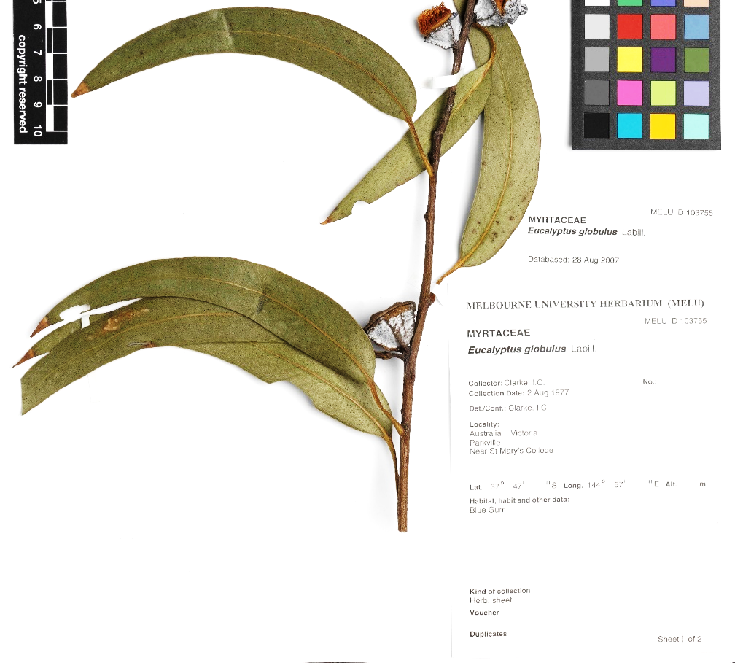
Results
Coordinates: 113
Scientific name: 46

Slide 15
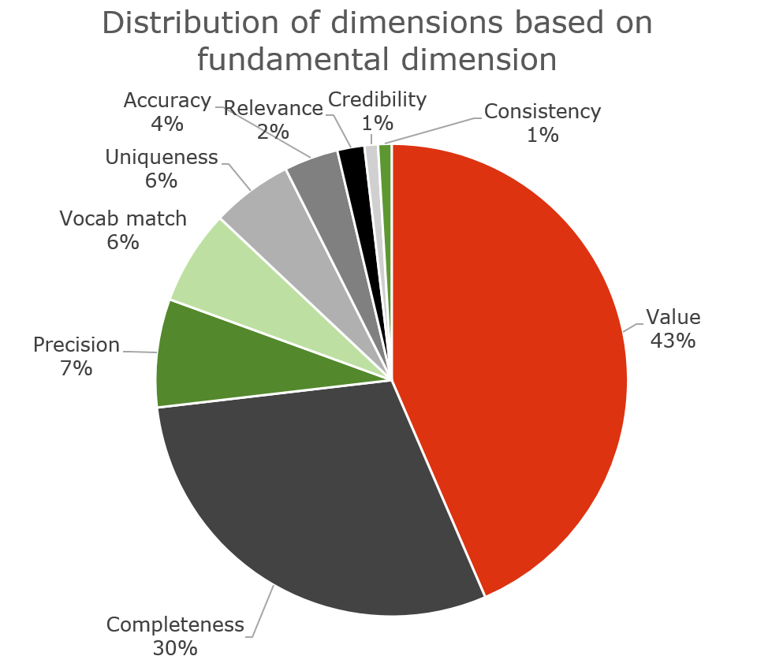
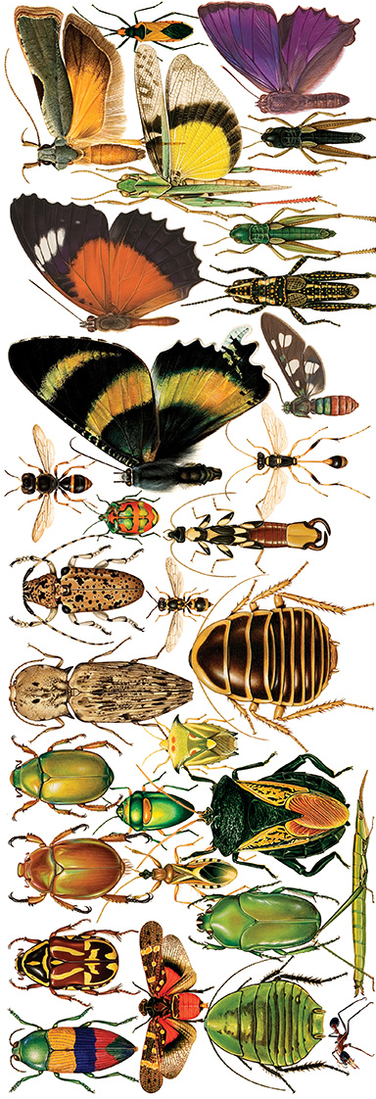
Results - Dimensions

Slide 16
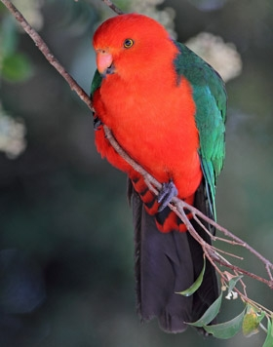
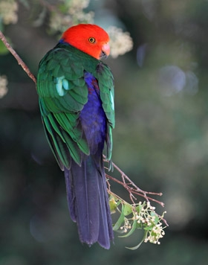
Results - Criteria
Alisterus scapularis Psittacidae, birdlife Australia

Slide 17
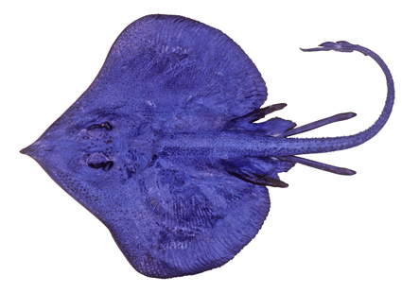
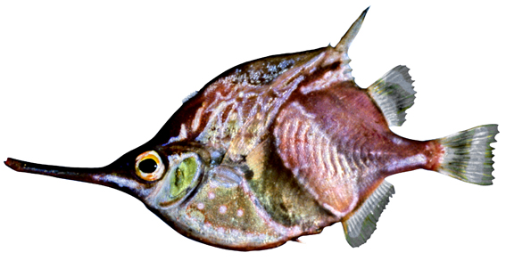
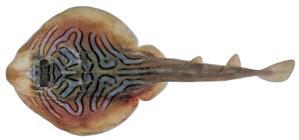
Summary
Fitness for use seems to be determined on very few aspects of a record
Location (coordinates), event date, and scientific name contain the most important information
Most often assessing value, completeness, and vocab match
Australian National Fish Collection Images

Slide 18
Recommendations
Require all new records uploaded include coordinates, date and scientific name
Ask data providers to update old records missing information
Include information with records about which taxonomic lists a scientific name matches
Ensure ALA data checks are accessible and understandable
Front end decision tree, worked example, number of records

Slide 19
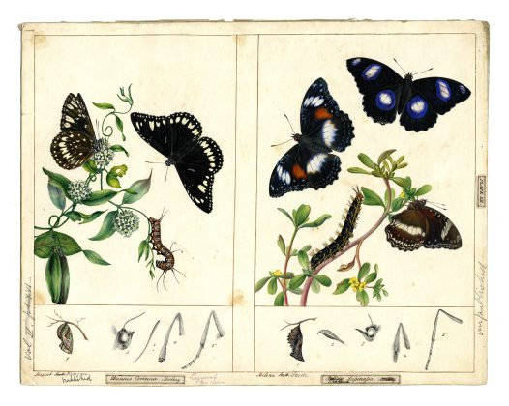
Acknowledgements
Thanks to
Miles Nicholls and all the ALA staff
The researchers who filled out the google form, sat down for an interview, passed on a paper, or recommended others to get in contact with
All images from the ALA and CSIRO
Danais corinna Macleay, Diadema lassinassa, Harriet and Helena Scott

